Slide 1
Quiz on Lecture 3
Please receive the quiz handout from Cyrille, Oliver, Vincent, Jan
Complete the quiz in silence
Hand the quiz back

Slide 2
Quiz on Lecture 3
What is the main advantage of writing clean and maintainable code?
  It reduces technical debt and helps others understand the codebase easily
  It allows you to skip documentation completely
  It shortens the execution time of the program
  It makes adding new features effortless without any need for testing.
A developer writes a test to verify that a single function calculates a value correctly in isolation, without involving any databases or network calls. Which type of test does this best describe?
  Unit Test
  Integration Test
  End-to-End Test
  Pytest
What is the goal of using pull requests in a team project?
  To automatically merge any branch
  To share code updates with the team and get feedback before merging
  To make sure tests run before code goes live
  To delete old branches after pushing code
What does pyright do?
  It adds type-hints to your code
  It checks your code for PEP8 violations
  It automatically formats your code to be PEP8 compliant
  It checks your code for type violations
According to pytest's test discovery rules, which of the following function names would be identified as a valid test and executed when you run the `pytest` command?
  def check_addition():
  def addition_test():
  def test_addition():
  def run_test_addition():
Which sequence best describes the standard GitHub Flow?
  Create release from development -> Commit to release branch -> Push release to remote -> Open PR to main -> Merge and tag main for deployment -> delete your branch
  Branch hotfix from main -> Commit fix to hotfix -> Push hotfix to remote -> Merge hotfix directly into main -> Deploy main.
  Clone repository -> Commit directly to local main -> Push directly to remote main -> Manually notify team -> Ask for approval after pushing -> delete your branch
  Create feature branch from development -> Add local commits -> Push feature branch to remote -> Open Pull Request to development -> Review, approve, and merge -> delete your branch

Slide 3
Quiz on Lecture 3 (Answers)
What is the main advantage of writing clean and maintainable code?
  It reduces technical debt and helps others understand the codebase easily
  It allows you to skip documentation completely
  It shortens the execution time of the program
  It makes adding new features effortless without any need for testing.
A developer writes a test to verify that a single function calculates a value correctly in isolation, without involving any databases or network calls. Which type of test does this best describe?
  Unit Test
  Integration Test
  End-to-End Test
  Pytest
What is the goal of using pull requests in a team project?
  To automatically merge any branch
  To share code updates with the team and get feedback before merging
  To make sure tests run before code goes live
  To delete old branches after pushing code
What does pyright do?
  It adds type-hints to your code
  It checks your code for PEP8 violations
  It automatically formats your code to be PEP8 compliant
  It checks your code for type violations
According to pytest's test discovery rules, which of the following function names would be identified as a valid test and executed when you run the `pytest` command?
  def check_addition():
  def addition_test():
  def test_addition():
  def run_test_addition():
Which sequence best describes the standard GitHub Flow?
  Create release from development -> Commit to release branch -> Push release to remote -> Open PR to main -> Merge and tag main for deployment -> delete your branch
  Branch hotfix from main -> Commit fix to hotfix -> Push hotfix to remote -> Merge hotfix directly into main -> Deploy main.
  Clone repository -> Commit directly to local main -> Push directly to remote main -> Manually notify team -> Ask for approval after pushing -> delete your branch
  Create feature branch from development -> Add local commits -> Push feature branch to remote -> Open Pull Request to development -> Review, approve, and merge -> delete your branch

Slide 4
Designing and Deploying
end-to-end
Production Grade ML Applications
Lecture 4: CI/CD with Github Actions
October 2025
Vincent Frimpong & Cyrille Feudjio

Slide 5
Contents of this lecture
The Goal: Automating our workflow
What Exactly Is CI/CD?
Introducing Github actions
Core Concepts of Github Actions
CI/CD in Action: Three Core Use Cases
Use Case #1: Automating Code Quality Checks (CI)
Example Workflow: The CI Pipeline for Code Checks
Use Case #2: Automating Deployment (CD)
Example Workflow: The CD Pipeline for Deployment
Use Case #3: Automating Infrastructure (IaC)
Example Workflow: Provisioning with Opentofu
Tying It All Together: A Complete Workflow
Conclusion & Key Takeaways

Slide 6
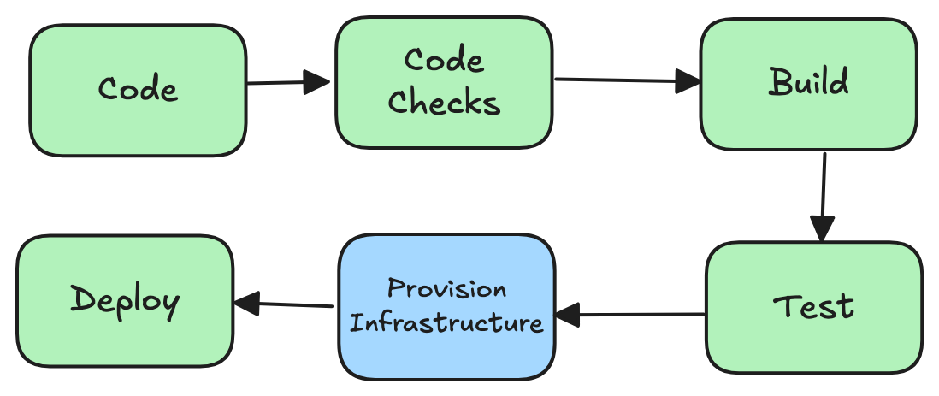
The Goal: Automating Our Workflow
We have learnt about Docker & Containers, Testing and writing clean code, and building interactive applications with Gradio. How do we automate the entire process of testing, packaging, and deploying our app reliably every single time we make a change?
Our goal is to create a system that automatically:
Validates our code quality and correctness.
Packages our Gradio app into a Docker container.
Deploys that container to a live environment on GCP(or any cloud provider).
Provisions the very infrastructure it runs on.

Slide 7
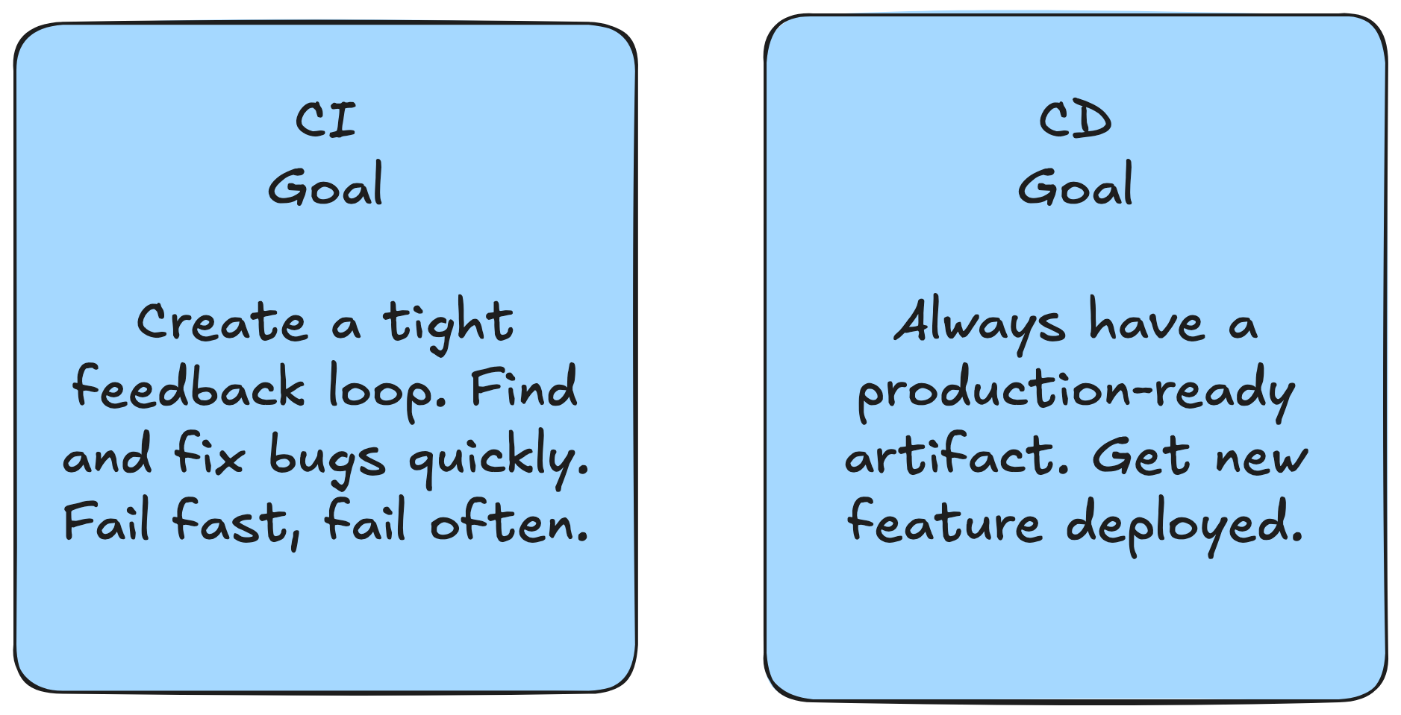
2. What Exactly Is CI/CD?
Continuous Integration (CI): The practice of frequently merging code changes into a central repository. After each trigger (eg. raising or merging a PR), automated builds and tests run.
Continuous Deployment (CD): The final step to automatically deploy every change that passes all tests directly to production.
CD is sometimes referred to as Continuous Delivery in projects that conclude with a formal release rather than a cloud deployment, such as libraries and packages.

Slide 8
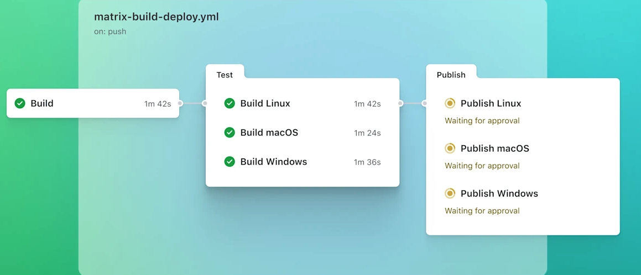
3. Introducing Github actions
A powerful CI/CD platform that lets you automate workflows directly from your GitHub repository. It's event-driven and deeply integrated with the GitHub ecosystem.
How does it work? You define workflows using YAML files in a special directory: .github/workflows/. Your workflows run on servers called runners(temporary vm’s that spin up to execute jobs). GitHub provides free runners for public repos.

Slide 9
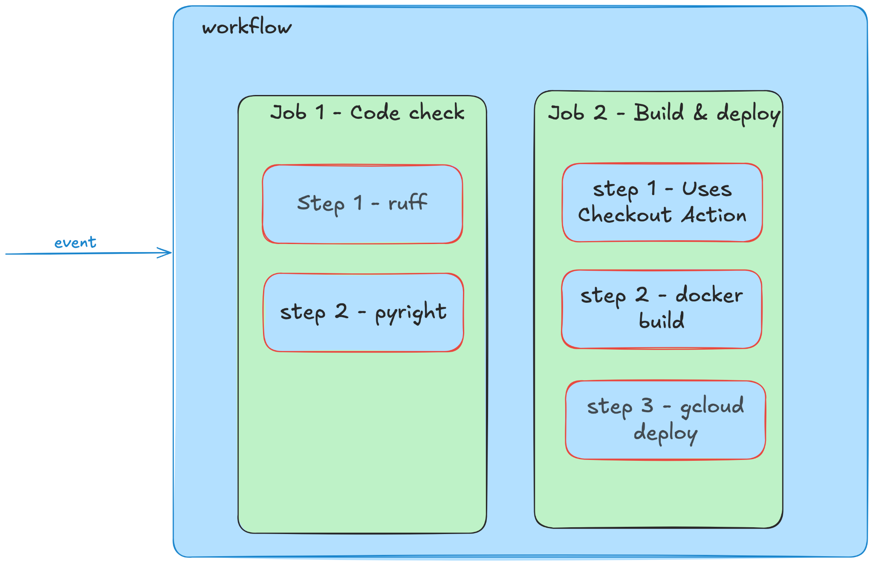
4. Core Concepts of Github Actions
Workflow: The top-level automated process defined in a .yml file. Triggered by an event.
Event: The trigger for the workflow (e.g., on: push or on: schedule).
Job: A collection of steps that execute on the same runner. Jobs run in parallel by default.
Step: An individual task. Can be a shell command (run:) or a pre-packaged script called an action (uses:).
Action: A reusable, community-built unit of code that performs a complex task (e.g., actions/checkout@v4 to get your code, or docker/build-push-action@v5 to build a Docker image).

Slide 10
4. Core Concepts of Github Actions
You can think of the entire process like following a recipe to bake a cake:
Event: Deciding to bake the cake for a birthday
Workflow: The entire recipe from start to finish
Job: A major stage in the recipe, like Bake the Sponge or Make the Icing. Each can be done in a different part of the kitchen (on a different Runner)
Step: A single instruction in a stage, like Preheat the oven or Mix flour and sugar
Action: Using a pre-made tool or ingredient mix to simplify a step, like using a Boxed Cake Mix instead of measuring the flour, sugar, and baking soda yourself

Slide 11
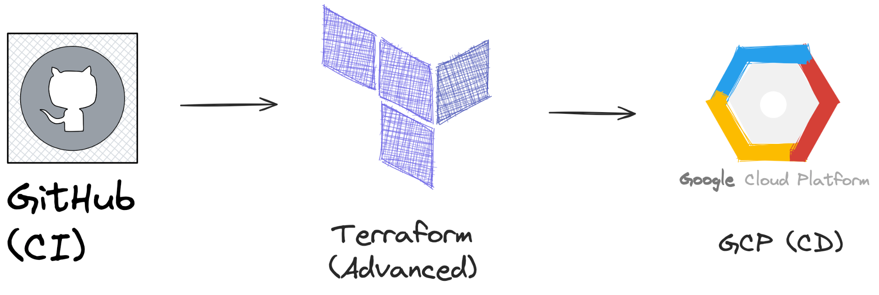
5. CI/CD in Action: Three Core Use Cases
Let's explore how we use these concepts in practice.
Automating Code Checks (The "CI" part)
Automating Application Deployment (The "CD" part)
Automating Infrastructure Provisioning (Advanced CD, if used, typically happens before Deployment)

Slide 12
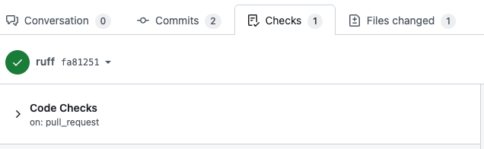
6. Use Case #1: Automating Code Quality Checks (CI)
Enforcing the Best Practices from Lecture 3
This is the foundation of any CI/CD pipeline. Before we build or deploy anything, we must ensure the code is high-quality. If this CI pipeline fails, it prevents from merging a PR into the development branch. Enforces high code standards!
What we automate:
Linting: Checking for stylistic errors and bad patterns (e.g., with ruff to ensure PEP8 coding standards & more).
Static Analysis: Finding potential bugs and code smells without running the code. (e.g., with pyright)
Testing: Running our unit and integration tests (e.g., with pytest).
Vulnerability Scanning: Scanning dependencies (pyproject.toml) for known security issues. (*advanced)

Slide 13
7. Example Workflow: The CI Pipeline for Code Checks
For a full production example see this code checks for this course’s repository here. The workflow below shows the fundamental steps for automating code quality checks.
name: Code Checks
on: [pull_request]
jobs:
run-code-checks:
runs-on: ubuntu-latest
steps:
- name: Checkout repository
uses: actions/checkout@v4
- name: Set up Python
uses: actions/setup-python@v5
- name: install uv
uses: astral-sh/setup-uv@v5
- name: install python packages
run: uv sync
- name: Run linter, type-checker, and tests
run: |
uv run ruff check .
uv run pyright

Slide 14
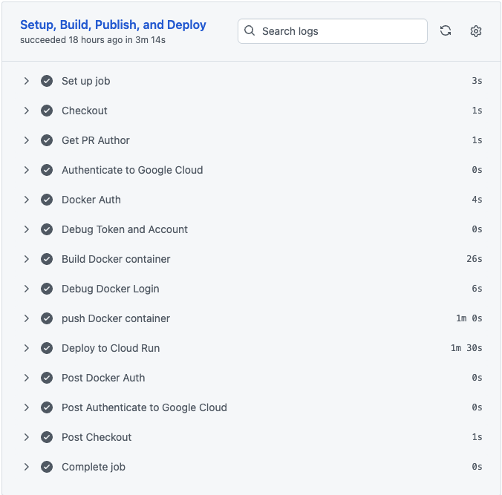
8. Use Case #2: Automating Deployment (CD)
Shipping the Docker Container from Lecture 2
Once our code is validated, the next step is to package and deploy it. For our Streamlit/Gradio app, this means building a Docker image and pushing it to a container registry.
What is a Container Registry? It's a storage system for your Docker images, like a "GitHub for Docker." Popular ones are:
Docker Hub
GitHub Container Registry(GHCR)
Google Artifact Registry (GAR) — what we use in this course

Slide 15
9. Example Workflow: The CD Pipeline for Deployment
To see the full deployment pipeline used in this course’s repository, see here. This is a simplified version of the workflow.
name: Build, Publish and Deploy
# Run this workflow only on pushes to the 'development' branch
on:
push:
branches: [ development ]
# Set key variables for the job
env:
PROJECT_ID: 'your-gcp-project-id'
GCP_REGION: 'europe-west2'
SERVICE_NAME: 'my-ml-app'
jobs:
build-and-deploy:
runs-on: ubuntu-latest
permissions:
contents: 'read'
id-token: 'write' # Required for GCP authentication
steps:
# 1. Get the code from the repository
- name: Checkout repository
uses: actions/checkout@v4
# 2. Authenticate to Google Cloud
- name: Authenticate to GCP
uses: 'google-github-actions/auth@v2'
with:
credentials_json: '${{ secrets.GCP_SA_KEY }}'
# 3. Build and push the image to Google Artifact Registry
- name: Build and Push Docker Image
uses: docker/build-push-action@v5
with:
push: true
tags: ${{ env.GCP_REGION }}-docker.pkg.dev/${{ env.PROJECT_ID }}/my-repo/${{ env.SERVICE_NAME }}:latest
# 4. Deploy the new image to Google Cloud Run
- name: Deploy to Cloud Run
uses: 'google-github-actions/deploy-cloudrun@v2'
with:
service: ${{ env.SERVICE_NAME }}
region: ${{ env.GCP_REGION }}
image: ${{ env.GCP_REGION }}-docker.pkg.dev/${{ env.PROJECT_ID }}/my-repo/${{ env.SERVICE_NAME }}:latest

Slide 16
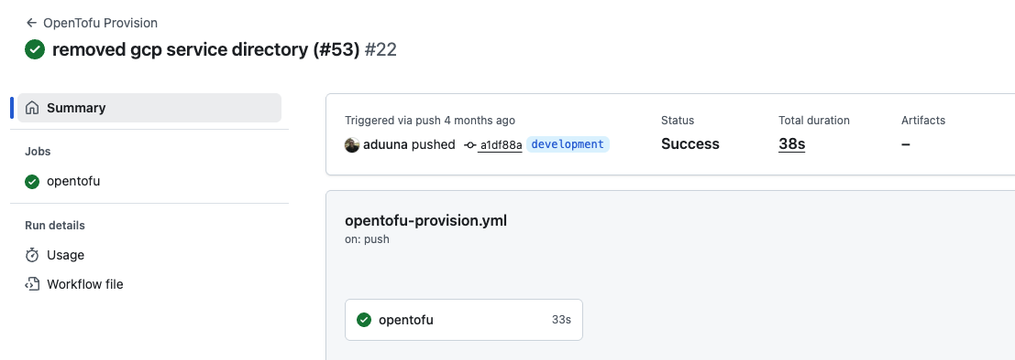
10. Use Case #3: Automating Infrastructure (IaC)
Provisioning the Servers Themselves : What if our application needs a database, a cloud storage bucket, or a specific server configuration? We can automate the creation of this infrastructure using Infrastructure as Code (IaC).
IaC: The practice of managing and provisioning infrastructure through code and version control, rather than through manual configuration (“ClickOps”). Examples of the tools used are: Terraform, Opentofu (Open source version of Terraform), AWS CloudFormation etc.
You write code (e.g. in Terraform HCL language) that declares what cloud resources you need. See example here. Then configure a pipeline that checks and applies them to create the infrastructure on your cloud provider of choice.

Slide 17
11. Example Workflow: Provisioning with Opentofu
For a full production example see this opentofu provisioning pipeline here. The workflow below is a simplified version
name: OpenTofu Plan
# Run only when a pull request changes files in the 'opentofu' directory
on:
pull_request:
paths:
- 'opentofu/**'
jobs:
plan-infrastructure:
runs-on: ubuntu-latest
steps:
- name: Checkout code
uses: actions/checkout@v4
- name: Setup OpenTofu
uses: opentofu/setup-opentofu@v1
- name: Authenticate to GCP
uses: 'google-github-actions/auth@v2'
- name: Run OpenTofu Plan
run: |
cd opentofu
tofu init
tofu plan
name: OpenTofu Apply
on:
push:
branches: [ main ]
paths:
- 'opentofu/**'
jobs:
apply-infrastructure:
runs-on: ubuntu-latest
steps:
- name: Checkout code
uses: actions/checkout@v4
- name: Setup OpenTofu
uses: opentofu/setup-opentofu@v1
- name: Authenticate to GCP
uses: 'google-github-actions/auth@v2'
- name: Run OpenTofu Apply
run: |
cd opentofu
tofu apply -auto-approve

Slide 18
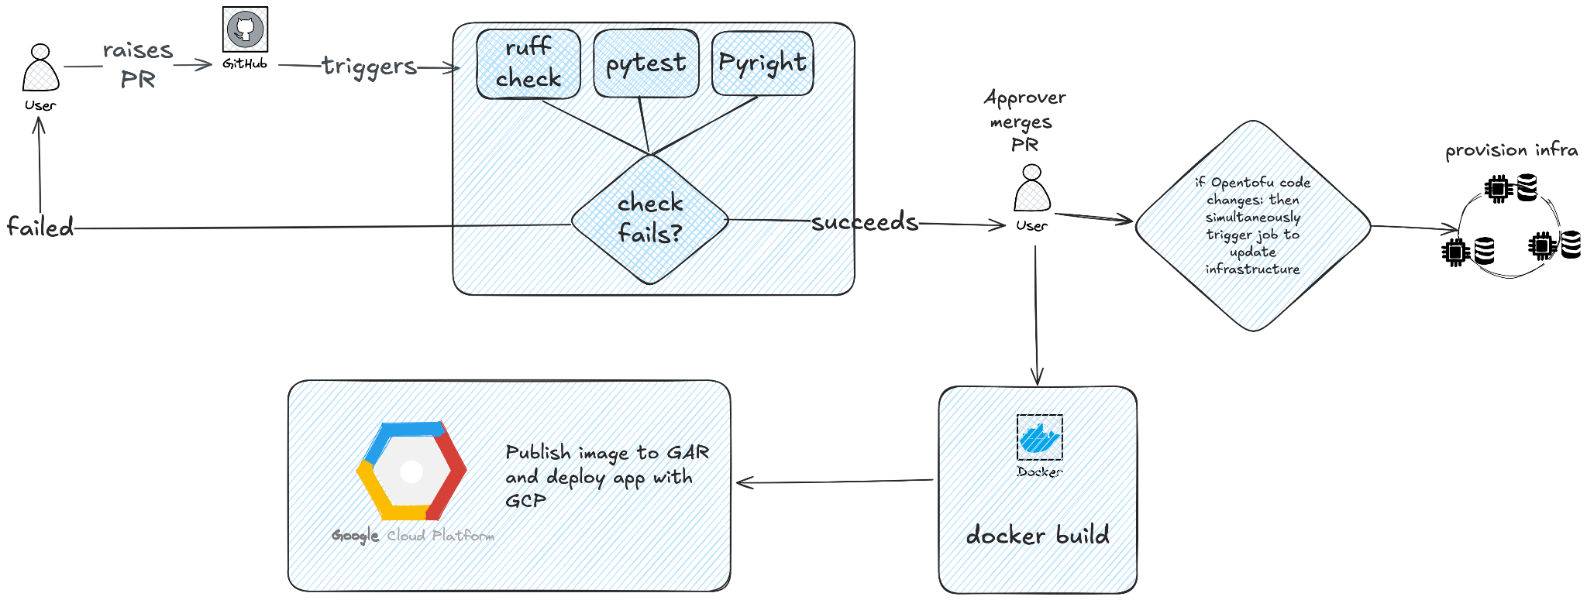
12. Tying It All Together: A Complete Workflow
Our three use cases form a logical progression for a mature MLOps pipeline.
A developer raises PR.
The CI Job triggers, running linting and tests.
If CI succeeds, an approver merges the code and CD Job triggers, building a new Docker image and pushing it to a registry.
Simultaneously, if infrastructure code was changed, the IaC Job triggers to update the cloud environment.
Finally, a deployment step pulls the new Docker image and runs it on the provisioned infrastructure.

Slide 19
13. Conclusion & Key Takeaways
Some other best practices to consider:
Version Everything: version code and infrastructure with git.
Use Secrets for All Sensitive Data - Never hardcode API keys, passwords, or credentials in your yaml — we use GitHub Secrets in this course
Fail Fast: Design your pipeline so that the fastest checks
GitHub Actions is a powerful, integrated platform for building these automated workflows. We explored three core use cases: Code Quality (CI), Application Deployment (CD), Infrastructure Provisioning (IaC). It can be used for so much more like automation (sending notifications), monitoring, and testing.
To practice on your own separate repository (create a dummy repository on Github if you don’t have one), then follow this quickstart guide: try to Implement a CI/CD Pipeline (i.e Create a workflow to run pytest on every push. Make sure it fails if you intentionally introduce an error.)

Slide 20
Assignment 1 (work in pairs)
Proposition A: Build a Gradio app that allows a user to enter text, perform different text operations, and display the result in a single output box.
Requirements:
An input textbox at the top where the user can type or paste any text.
An Accordion or Tabbed interface below with at least three sections:
  Section 1: Case Converter
    Has radio buttons for "Uppercase," "Lowercase," and "Title Case."
  Section 2: Text Reverser
    Has a checkbox for "Reverse Word Order."
    Has another checkbox for "Reverse All Characters."
  Section 3: Text Analyzer
    Displays the Word Count, Character Count, and Average Word Length of the input text.
A single output textbox that updates based on the selected operations.
Go a bit further:
For example: Add a "Clear" button
For example: Display statistics dynamically as the user types
Anything else you can think of (extra points awarded for creativity)!

Slide 21
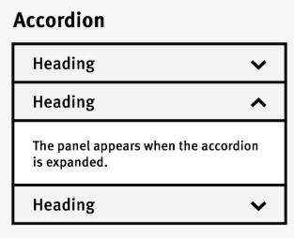
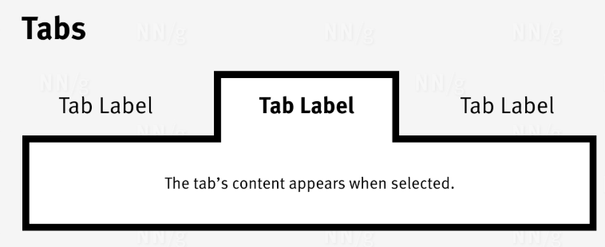
Assignment 1 (work in pairs)

Slide 22
Assignment 1 (work in pairs)
Proposition B: Build a Gradio app that that allows a user to upload an image, apply basic editing operations, and view the updated image
An image upload component for the user's input image.
Several controls to manipulate the image:
  A checkbox to convert the image to Grayscale.
  A slider (from 0.5 to 1.5) to adjust Brightness.
  A slider (from 0.5 to 1.5) to adjust Contrast.
  A slider (from -180 to 180 degrees) to Rotate the image.
An output image display that updates the input image
Go a bit further:
For example: Add a "Reset" button to revert to the original image
For example: Add a "Download" button to save the edited image
Anything else you can think of (extra points awarded for creativity)!

Slide 23
Assignment 1 (work in pairs)
Instructions to help you:
create a feature branch from the development branch (e.g. feature-branch-{yourname})
create a new .py file inside gradioapp/
build the app
edit api/main.py
  mount it at the bottom of the file
  add a new markdown hyperlink near the top of the file, to show in the OpenAPI URL
To run your app locally for testing purposes, type:
  cd src/students/$GITHUB_USER
  uvicorn "api.main:app" --reload --port 8080
Raise a PR to merge your feature branch into the development branch
Merge the PR and watch the app get deployed!
Send us in the slack channel:
  the names of the two members in your group
  a link of your merged PR
  the OpenAPI URL
  a brief description of the contributions you each made
TIP: use GenAI to help you. But beware — it often gives rubbish code

Slide 24
Q&A
Questions?

